Slide 1
◊ IoT Hands-on Labs ◊ Lab 4. ThingWorx
IoT Lecture Series
Prof. John Lee
IUPUI & KAIST

Slide 2
ThingWorx Academic Tutorial
Follow tutorial here (on your own)
https://www.udemy.com/thingworx-fundamentals/
Create an account on https://www.thingworxacademic.com/
Registration Code: fundamentals17
See next slide

Slide 3
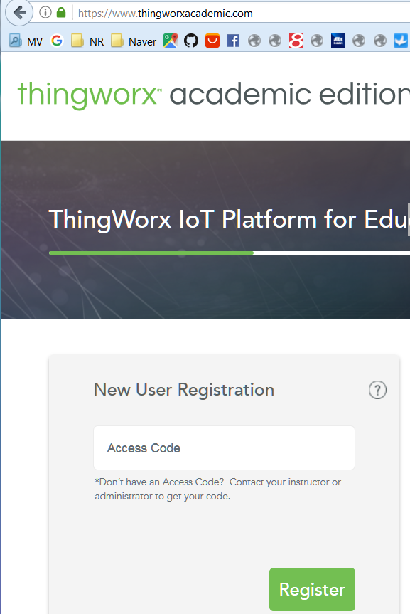
fundamentals17

Slide 4
ThingWorx Academic Tutorial
Use the following composer for experiment
(use same user ID and password as thingworxacademic.com)
https://academic.cloud.thingworx.com/Thingworx/Composer/
We will do something very similar to this
https://www.thingworx.com/ecosystem/academic-program/iot-projects/weather-app-arduino-uno/
Continue next slide

Slide 5
ThingWorx Arduino Tutorial
use https://github.com/indystar1/ESP8266-code-various/REST_ESP8266_ThingWorx_JSON_LED_control
If you have not downloaded the folder, clone or download
(Need Arduino IDE and ESP8266 library to program WeMos D1 ESP8266)
we did this in earlier labs
Follow Lab_34.ThingWorx_experiment.pdf
Create a Thing with five Properties: Temperature (Number), Humidity (Number), AnalogValue (Number), BoolStatus (Boolean), and MyControl (Boolean).

Slide 6
ThingWorx Arduino Tutorial
Also create a Service whose name is setTempAndHumid with the following Script:
Continue next slide
var isTrueSet = (Bool.toLowerCase() === 'true');
me.Temperature = parseFloat(Temp) ;
me.Humidity = parseFloat(Humid) ;
me.BoolStatus = isTrueSet ;
me.AnalogValue = parseFloat(Analog) ;

Slide 7
ThingWorx Arduino Tutorial
Use the same board we used in the previous lab
Modify REST_ESP8266_ThingWorx_JSON_LED_control.ino
Modify the WiFi ssid, password, appKey, etc.
Connect power to the hardware.
Setup target board, port, speed, etc.
Compile
Upload to ESP8266

Slide 8
Debugging (if it doesn’t work well)
Use Advanced REST client (chrome extension)
Command to use
POST /Thingworx/Things/Your_Thing_Name/Services/setTempAndHumid?appKey=your_app_key&method=post&x-thingworx-session=true&Temp=56.70&Humid=34.50 HTTP/1.1
Host: academic.cloud.thingworx.com
Content-Type: text/html

Slide 9
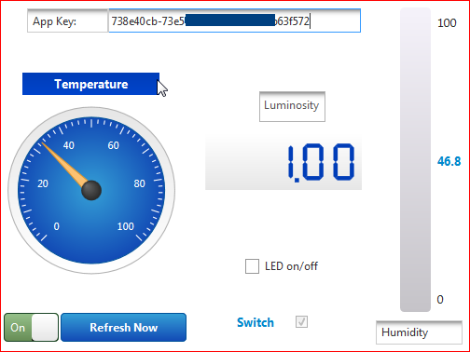
Mashup (GUI)
Next, create a Mashup like this:

Slide 10
Mashup (GUI)
Launch the mashup and see if data change.
Try to turn Switch on and off and check Switch check box.
Try to cover photoresistor to see if Luminosity changes.
Now check or un-check LED on/off to see if LED2 on the board is turned on or off.

Slide 11
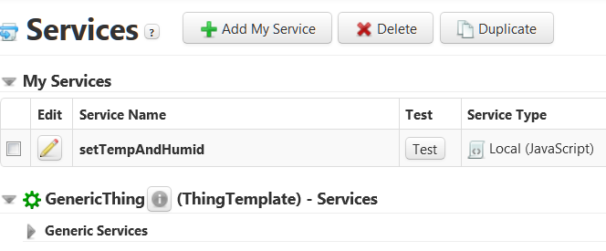
Testing the Service
You could test your Service by clicking [Test] button in the Service entity.

Slide 12
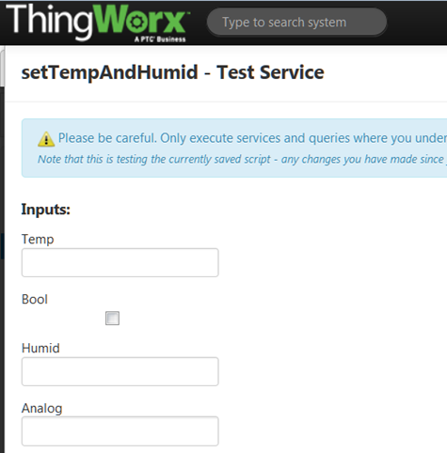
Service Testing Window
It will show the following Test Service Window, by which you can test your service.

